Slide 1

Ramrao Adik Institute of Technology
Department of Computer Engineering
BE Project Presentation
On
“Personality Prediction”
By
Roll No. Name
17CE7001 Mansi Pable
17CE7027 Jeet Choudhari
17CE8008 Shital Nehete
Guided by
Mrs. Smita Bharne

Slide 2
Outline
Introduction
Literature Survey of the existing systems
Limitations of the existing systems
Problem statement
System Design
Technologies and methodologies
Results and Analysis
Conclusion
References
BE Project Presentation

Slide 3
Introduction
The traits, set of etiquettes, emotional patterns define one's personality.
This project predicts Personality on Big 5 Traits,
Openness(inventive/curious vs. consistent/cautious)
Conscientiousness(efficient/organized vs. easy-going/careless)
Extroversion(outgoing/energetic vs. solitary/reserved)
Agreeableness(friendly/compassionate vs. challenging/detached)
Neuroticism(sensitive/nervous vs. secure/confident)
BE Project Presentation

Slide 4
  Motivation
Screen candidates based on predicted personality with the help of questionnaire
To help user compare his personality with others.
Diagnose mental health problems.
  Objectives
Develop an app to screen candidates for college, employment.
To diagnose psychological problems.
Focusing on strengths, weaknesses, temperament, and style of leadership.
Predict personality at workplace as well as for personal inventories.
BE Project Presentation

Slide 5
Literature Survey
Sr. No. | Author | Title | Summary
1 | Majid Ramezani, Mohammad Reza Feizi Derakhshi, Mohammad-Ali Balafar, Meysam Asgari-Chenaghlu, 2020 | Automatic Personality Prediction; an Enhanced Method Using Ensemble Modeling | In this paper accuracy of Automatic Personality Prediction is reinforced from the text by using ensemble modeling. Here five different basic methods, are applied in ensemble modeling. Essays Dataset is used which is employed altogether on the methods. Further HAN is used as the meta model to implement stacking algorithm.
2 | Madhura Jayaratne, Buddhi Jayatilleke, 2020 | Predicting Personality Using Answers to open ended interview questions year | Personality is used to make hiring decisions within the selection process. Here data from over 46,000 job applicants who completed a web chat interview was collected. The training dataset for the experiment was collected from web chat-based interview tool

Slide 6
Literature Survey
Sr. No. | Author | Title | Summary
3 | Aditi V. Kunte, Suja Panicker, 2019 | Using textual data for Personality Prediction: A Machine Learning Approach | Three algorithms used are Multinomial Naïve Bayes, AdaBoost and LDA. The relevances are compared and the higher value is taken. Multinomial Naïve Bayes is observed to be giving 73.43 accuracy , precision as 0.7, recall of 0.71 followed by 0.72 as F1-score.
4 | Raad Bin Tareaf, Philipp Berger, Patrick Hennig, Christoph Meinel, 2018 | Personality Exploration System for Online Social Networks: Facebook Brands As a Use Case | The research in this paper is based on the Five-Factor Model(BIG 5), Linguistic Inquiry and Word Count features. Datasets used: Demographic Details, BIG5 Personality Scores, Facebook Status Updates(153.617). Out of Support Vector Machine, Gradient Boosting, Neural Nets, Gradient Boosting had the best outcome. XGB performed best with Openness as 6.93% with overall of 5.12%.

Slide 7
Sr. No. | Author | Title | Summary
5 | Abdur Rahman, Asif Al Faisal, Tayeba Khanam, Mahfida Amjad, Saeed Siddik, 2019 | Personality Detection from Text using Convolutional Neural Network | Data into numbers with Word2Vec model, non-neural sentences is filtered, finally given for classification. It aims at comparing the performance of ReLu and leaky ReLu.
6 | Guanqun Sun, Ao Guo, Jianhua Ma and Jianguo Wei, 2019 | Personal Trait Analysis Using Word2vec Based on User-generated Text | Words extracted using LDA/ lexions, then converted into vector. Scaled diversity on affect and social interaction with personal traits.
BE Project Presentation

Slide 8
Sr. No. | Author | Title | Summary
7 | Raad Bin Tareaf, Seyed Ali Alhosseini, Philipp Berger, Patrick Hennig, Christoph Meinel, 2019 | Towards Automatic Personality Prediction Using Facebook Likes Metadata | Facebook’s hierarchy to categorical pages as features, given as input to ML. A relation between metadata, mapped it to feature to calculate the big-five scores.
8 | Mariam Hassanein Wedad Hussein Sherine Rady Tarek F. Gharib, 2018 | Predicting Personality Traits from Social Media using Text Semantics | Measures similarities between text and vectors. Score is presented to how much user’s text is similar to vector using vector space model.
BE Project Presentation

Slide 9
Limitations
Smaller dataset - myPersonality sample dataset (250 users, 9917 status updates).
Semantic level analysis(terms and topics) used. Other types of features, such as the use of parts of speech (POS), readability, formality, use of emojis can further increase the accuracy.
Social networking sites like Facebook doesn’t directly provide needed data to researchers due to privacy reasons.
The accuracy of the analysis can have great impact due to the millions, trillions fake users on Facebook.
Only one way to predict the personality.
BE Project Presentation

Slide 10
Problem statement
Personality of the person plays a vital role in the response what a person gives when exposed to a situation. It can be difficult to predict when we meet the person for the first time. Study of personality is considered as a psychology research based on the survey or questionnaire. But this limits the research data to less number of persons. Hence there is a need of something through which we can automate the process. The project proposes prediction of user’s personality with 3 ways namely Text prediction, Questionnaire, Facebook.
BE Project Presentation

Slide 11
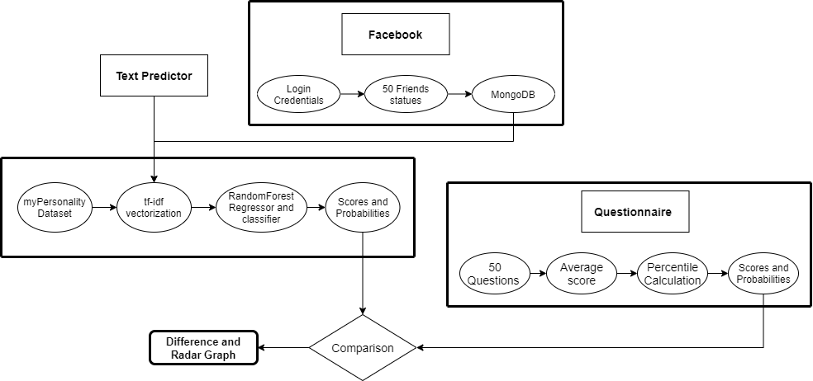
System Design
BE Project Presentation

Slide 12
The Web App consists of 3 sections:
Text Predictor:
My-personality Dataset
Model trained – Random Forest
tf-idf- text to vector
Vector - input to model
Predicted on regression as well as classification
Questionnaire:
No model used
Score based on selected options
Radar Graph
Facebook:
Login with user credentials
Scrape statuses of 5 friends
Score from Questionnaire and text predictor
Radar Graph
BE Project Presentation

Slide 13
Technologies and methodologies
React is used to design the user interface as it is a efficient and versatile JavaScript library . The Web App which can be created using React.js are going to be using backend as Flask and MongoDB.
Python is used as a programming language. Python is simple and its easy to find syntax emphasizes readability and thus reduces the value of program maintenance.
MongoDB is used to store Facebook statuses from web scraping and it is further used for prediction.
Selenium automated browser will scrape statuses from Facebook and add them to a database in MongoDB.
Node.js is used to run the web app
Random forest models give a prediction of personality score, using the regression model, and a probability of the binary class, using the classification model, for every personality trait.
BE Project Presentation

Slide 14
Implementation
myPersonality dataset consists 9918 rows which consists of sentences and the personality trait scores for each Big-5 traits for regression and outputs for classification also.
The textual data is converted into vectors using tf-idf Vectorization and the vectors are given as inputs to the Machine Learning algorithm.
Based on the data, the model are trained for regression as well as classification using Ensemble Bagging Random Forest Algorithm.
Number of trees used for Regression are 200 and for classification it is, 110.
After, the training of the model, they are saved in pickle files for the later predictions.
Text Predictor: The user inputs the text, the text is vectorised using tf-idf vectorisation and the trained models are imported and used for predicting the personality traits scores and percentiles.
BE Project Presentation

Slide 15
Questionnaire: The Questionnaire is prepared using 50 Questions, 10 for each personality trait. The scores entered by the user is averaged and the score is calculated. The percentileofscore function of stats class in used for converting to percentile based on an array of csv file. The Radar graph is used for the represent the personality scores of Big-5 traits.
Social Media: The user inputs the login credentials of the Facebook and they are stored in yaml file. 5 friends’ statuses are stored in Mongo DB and then the trained models are used for predicting the scores. The Radar Graph is used for presenting the scores. The compare option compares the scores and shows the difference between the user’s personality from questionnaire and the score of the statuses of friends in numeric as well as on Radar graph.
BE Project Presentation

Slide 16
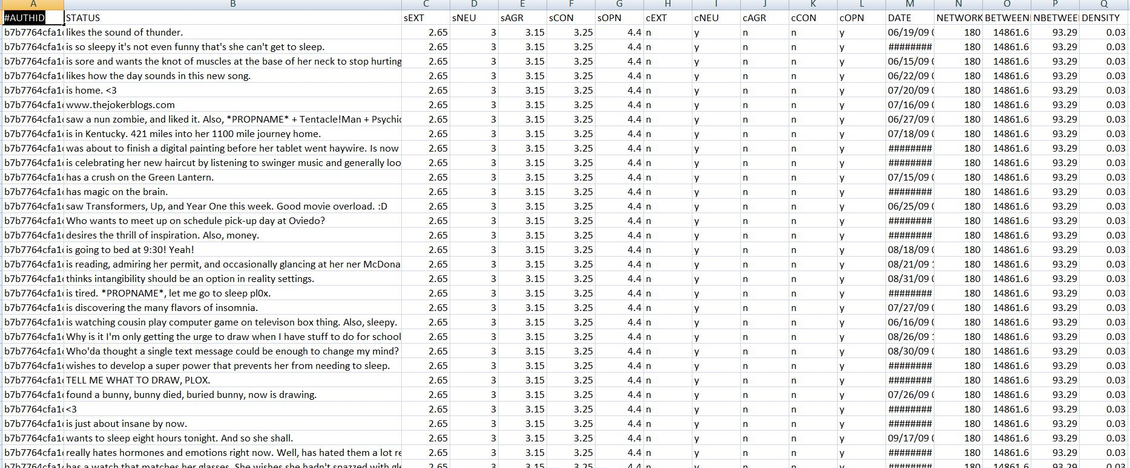
myPersonality Dataset
BE Project Presentation

Slide 17
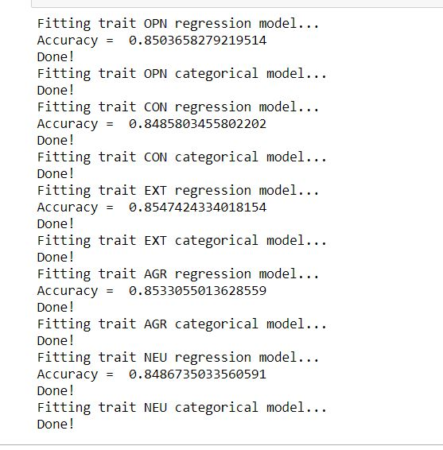
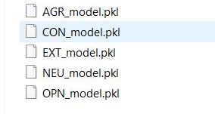
BIG-5 traits model accuracy and pickle files
BE Project Presentation

Slide 18
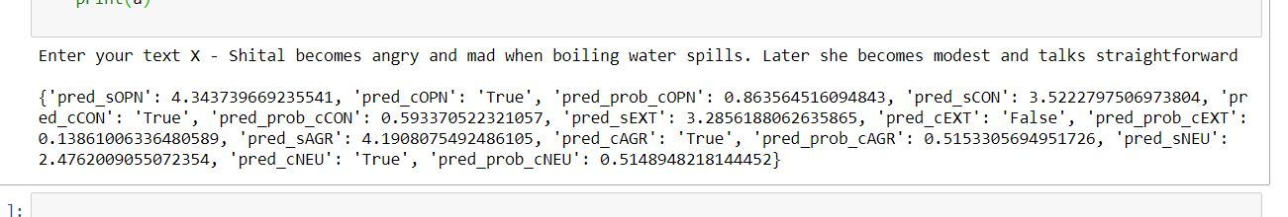
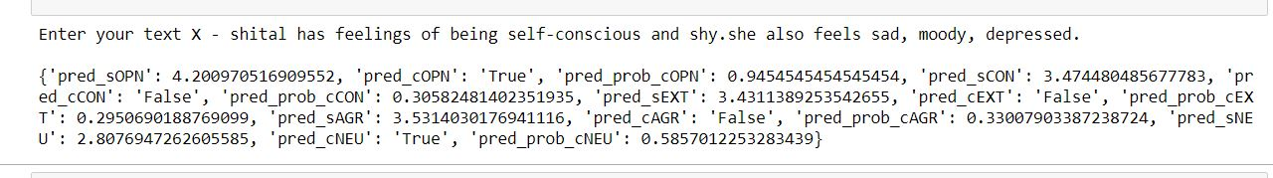
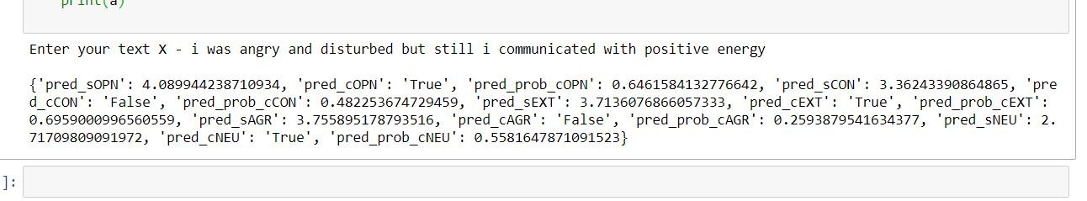
Text Predictions
BE Project Presentation

Slide 19
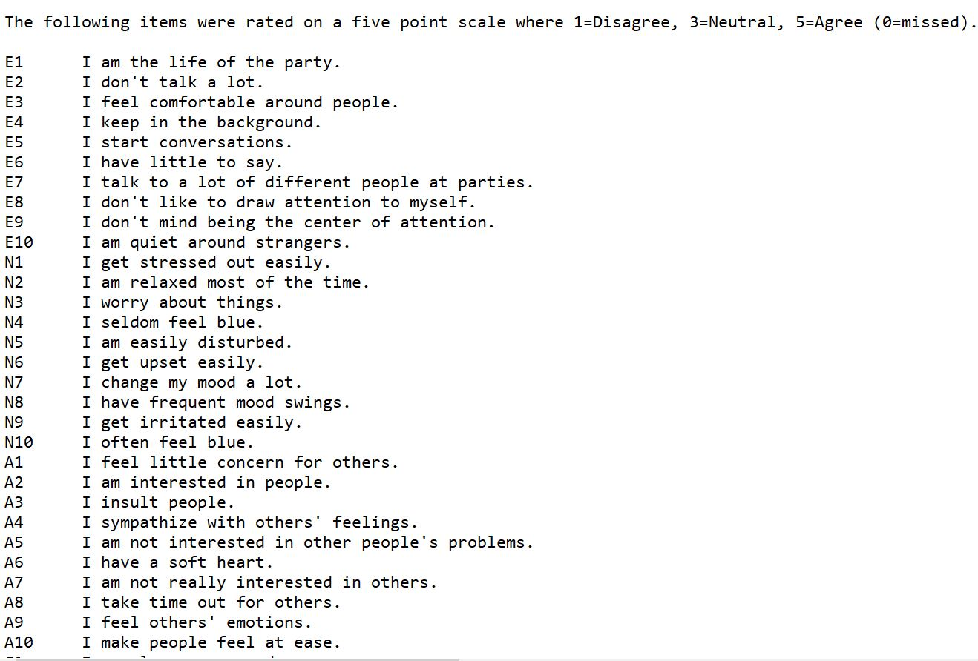
Questions for Personality Questionnaire
BE Project Presentation

Slide 20
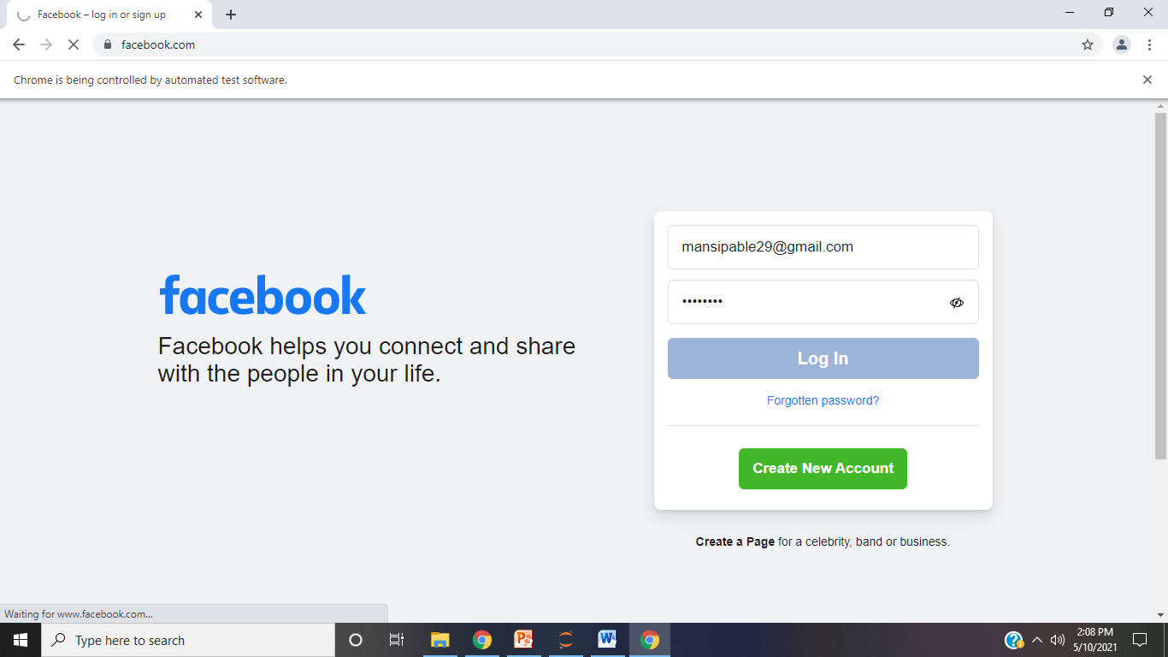
Facebook Automation through Selenium
BE Project Presentation

Slide 21
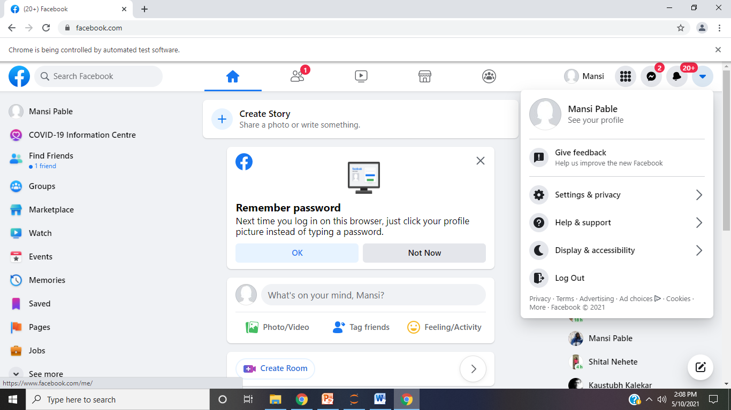
BE Project Presentation

Slide 22
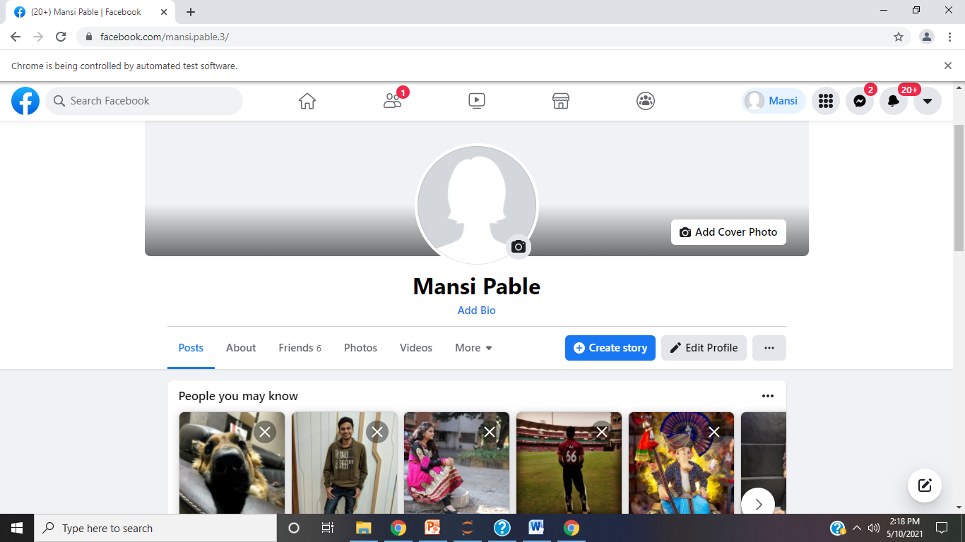
BE Project Presentation

Slide 23
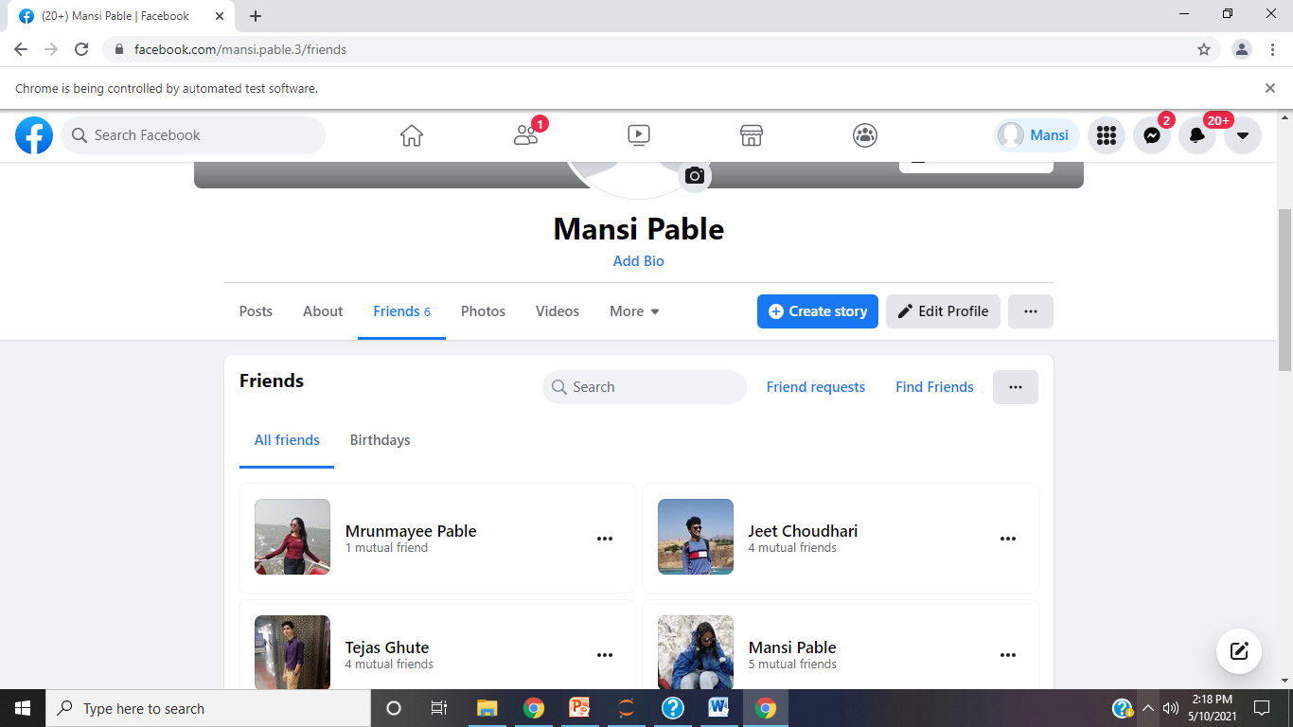

BE Project Presentation

Slide 24
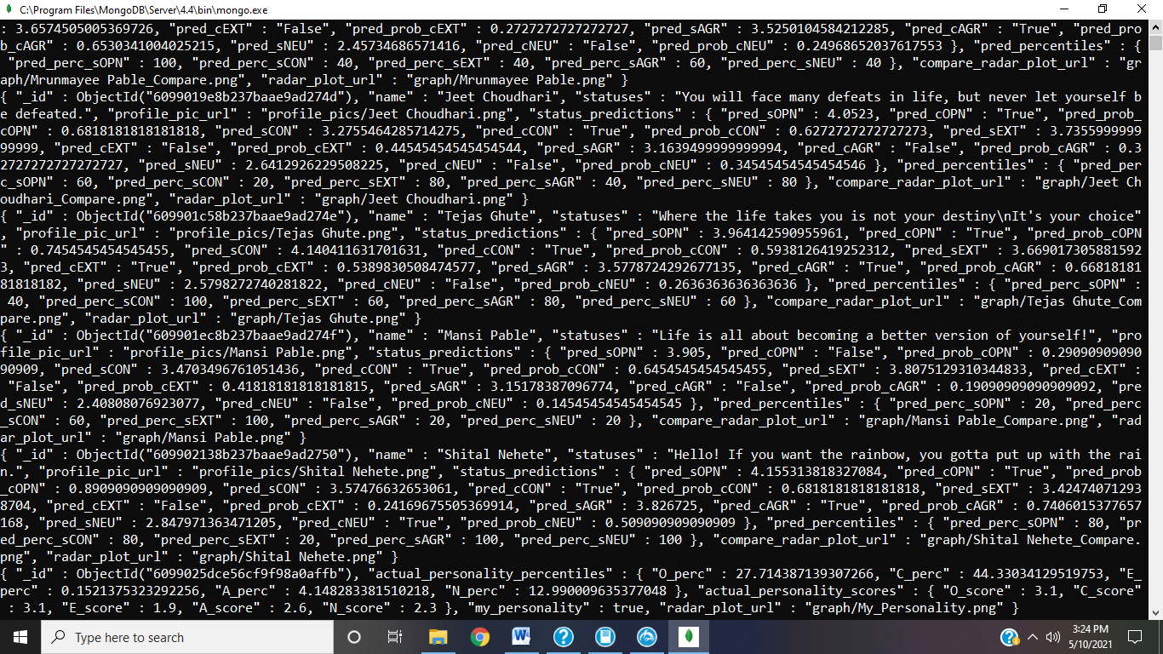
Personality scores predicted in MongoDB
BE Project Presentation

Slide 25
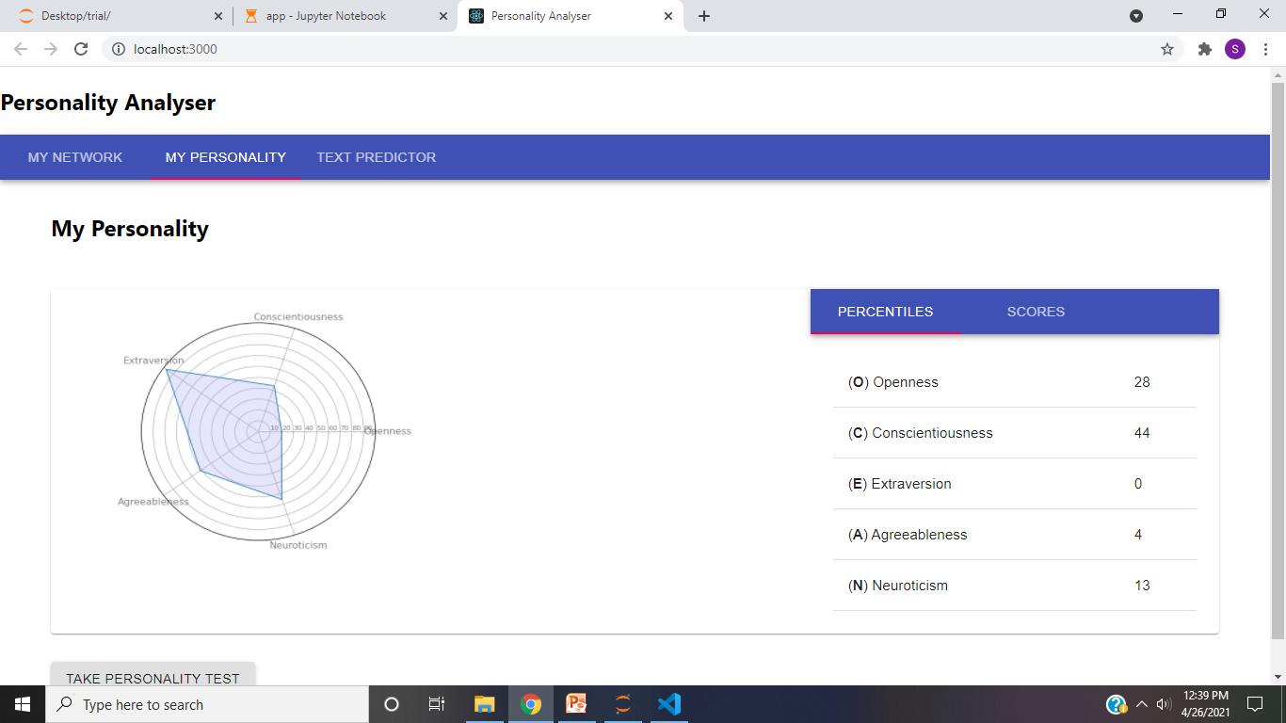
User Interface
BE Project Presentation

Slide 26
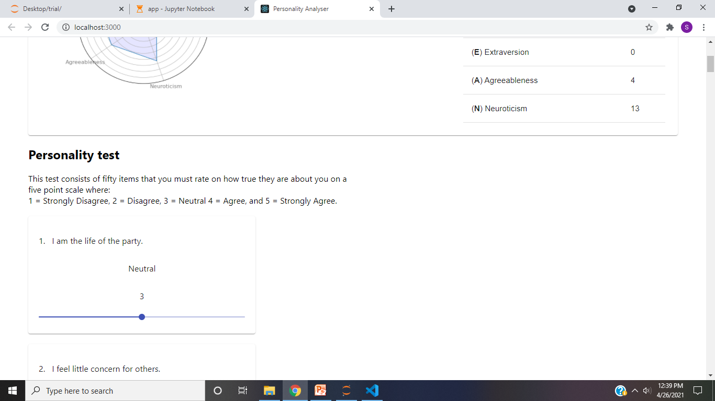
BE Project Presentation

Slide 27
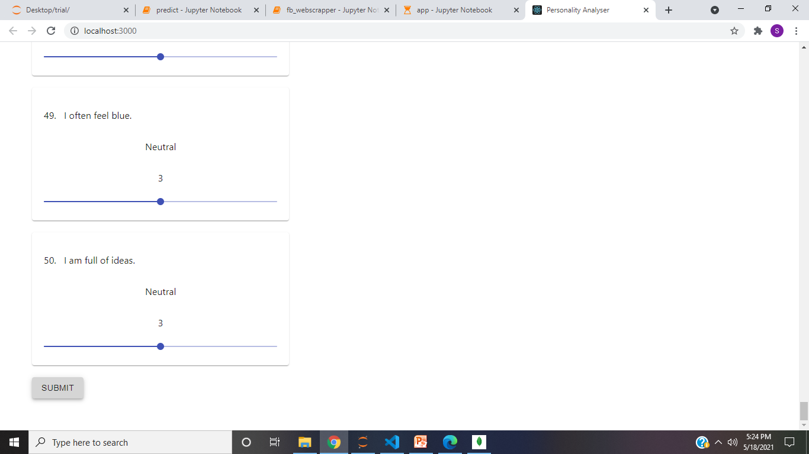
BE Project Presentation

Slide 28
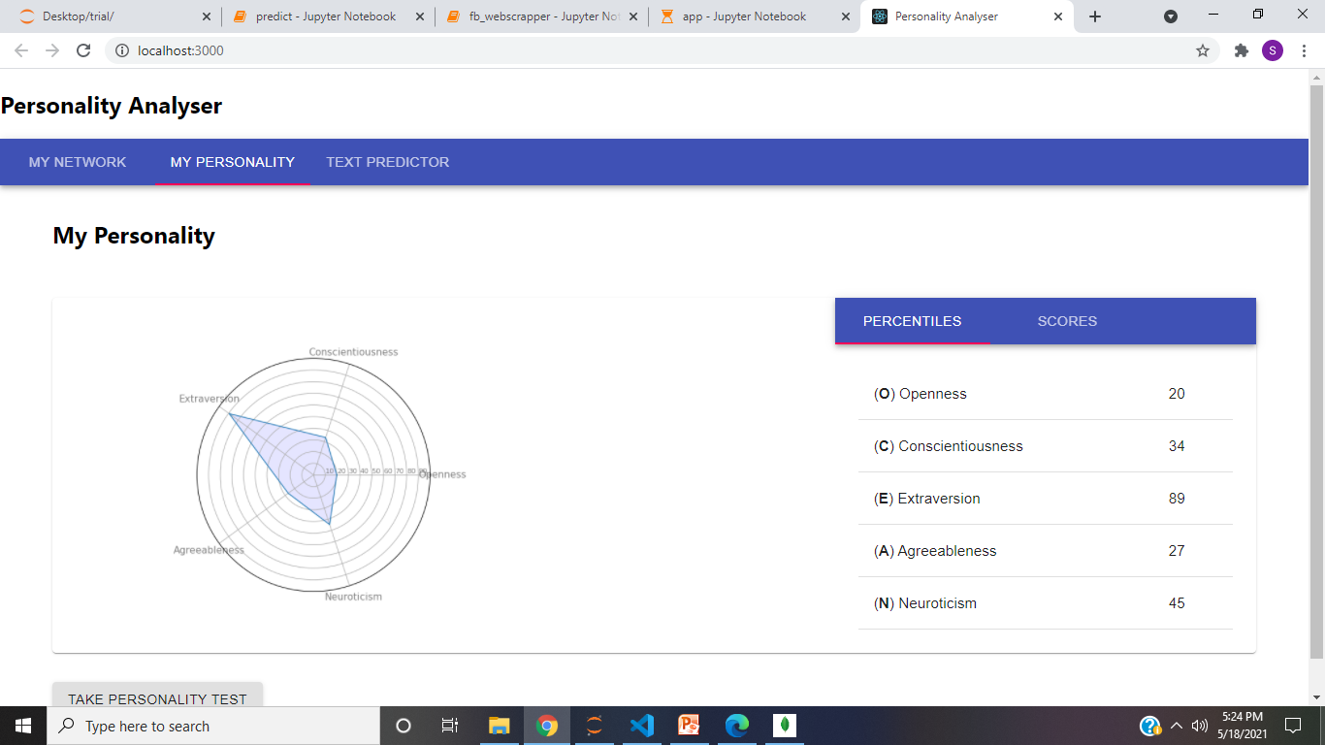
BE Project Presentation

Slide 29
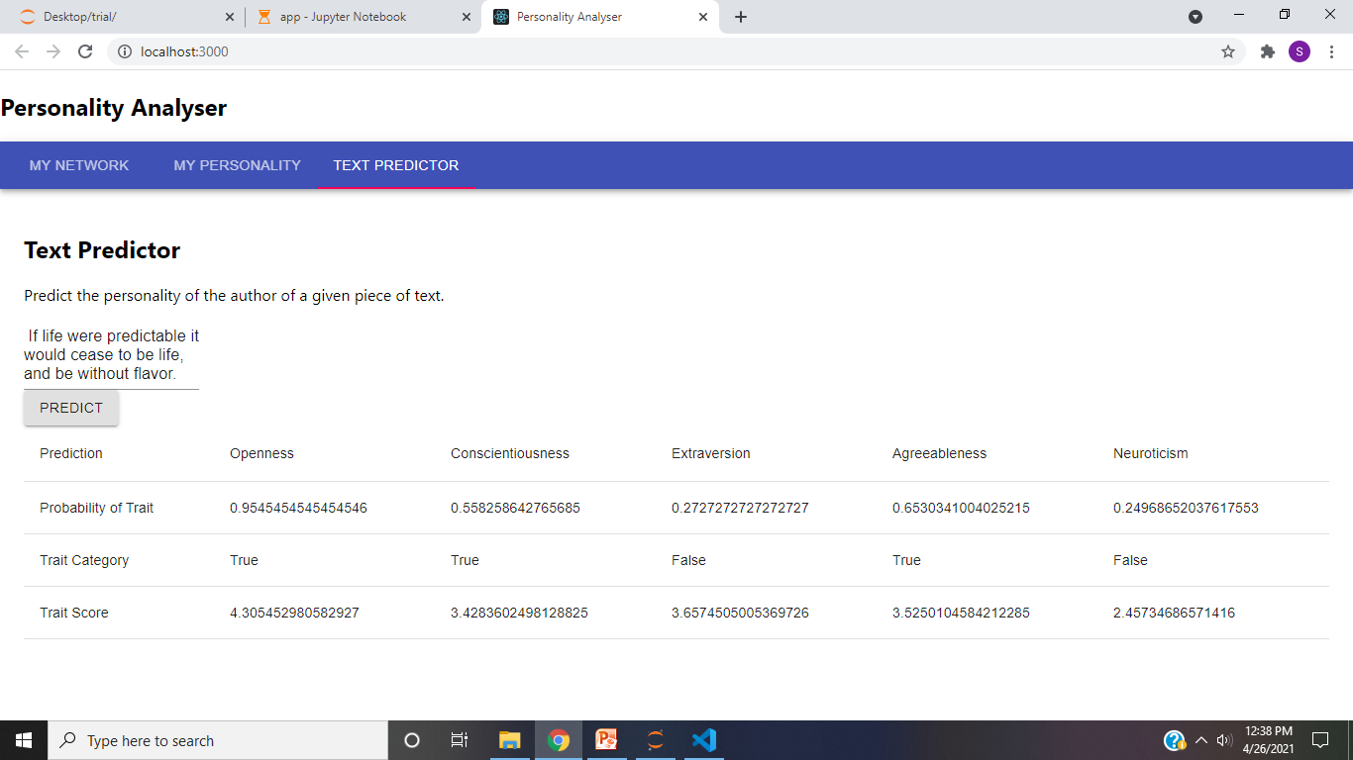
BE Project Presentation

Slide 30
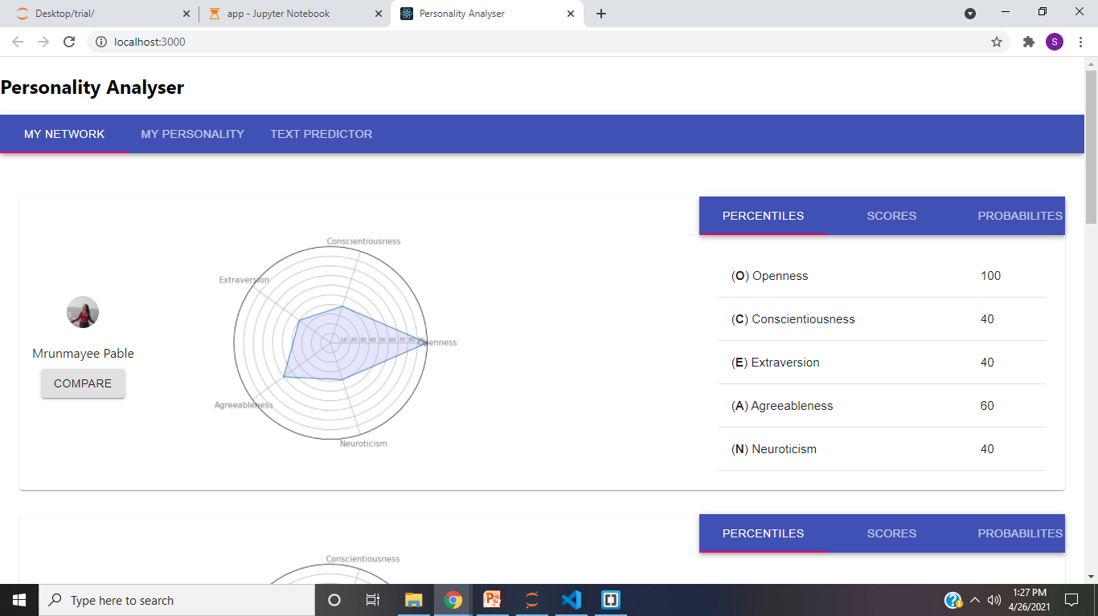
BE Project Presentation

Slide 31
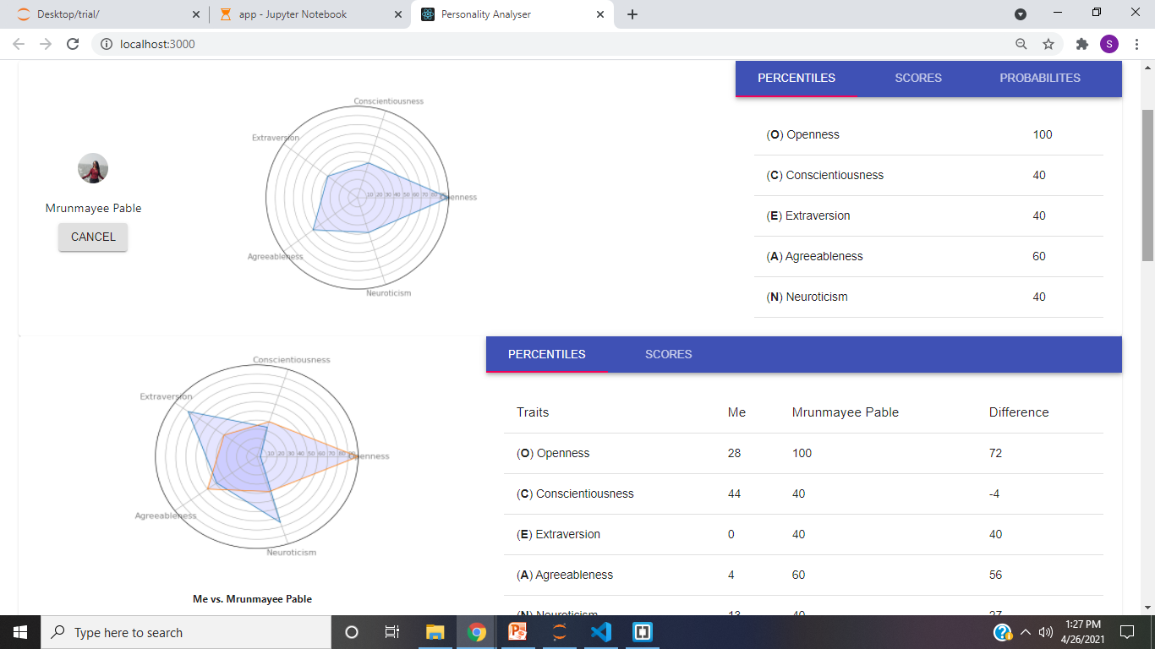
BE Project Presentation

Slide 32
Results and Analysis
The Selenium automated system will give user a better analysis for the personality as it compares the scores with others.
If the user feels one way isn’t sufficient for prediction, he can go for the other.
This system consists of questionnaire as well as text prediction of personality and also, the user can compare his personality with his Facebook’s friends.
Combining these methods can help the user to get the result on only one platform instead of searching for another.
The comparison tab can provide self-analysis to the user for the field he/she is lacking w.r.t. to the another.
BE Project Presentation

Slide 33
 | Traits
Algorithm | OPN | CON | EXT | AGR | NEU
Naïve Bayes | 70.00% | 59.20% | 68.80% | 56.40% | 54.40%
SVM | 70.40% | 56.00% | 61.60% | 56.80% | 60.40%
Logistic Regression | 70.40% | 54.40% | 68.40% | 53.60% | 60.40%
Gradient Boosting | 63.20% | 56.40% | 68.00% | 63.20% | 59.20%
LDA | 70.00% | 58.40% | 68.00% | 58.00% | 60.80%
BE Project Presentation

Slide 34
Conclusion
The accuracy for regression models are Openness – 85.03%, Conscientiousness – 84.85%, Extraversion – 85.47%, Agreeableness – 85.33% and Neuroticism – 84.86%.
The scores and percentile for prediction is represented on UI and Radar Graph as shown for visual representation.
Future Works, as the dataset is very small the accuracy of the model is suffered.
Also, the prediction can suffer because the person writing or answering might influence his/her answer resulting in the wrong scores.
Also, the questions in questionnaire are limited resulting in limited judgment of the personality traits.
BE Project Presentation

Slide 35
References
[1] Majid Ramezani, Mohammad Reza Feizi Derakhshi, Mohammad-Ali Balafar, Meysam Asgari-Chenaghlu, “Automatic Personality Prediction; an Enhanced Method Using Ensemble Modeling”, 2020
[2] Madhura Jayaratne, Buddhi Jayatilleke , “Predicting Personality Using Answers to open-ended interview questions”, 2020
[3] Aditi V.Kunte, Suja Panicker , “Using textual data for Personality Prediction: A Machine Learning Approach”, 2019
[4] Abdur Rahman, Asif Al Faisal, Tayeba Khanam, Mahfida Amjad, Saeed Siddik, “Personality Detection from Text using Convolutional Neural Network,” IEEE, 2019.
[5] Guanqun Sun, Ao Guo, Jianhua Ma and Jianguo Wei, “Personal Trait Analysis Using Word2vec Based on User-generated Text,” IEEE, 2019.
[6] Raad Bin Tareaf, Seyed Ali Alhosseini, Philipp Berger, Patrick Hennig, Christoph Meinel, “Towards Automatic Personality Prediction Using Facebook Likes Metadata,” IEEE, 2019.
[7] Mariam Hassanein, Wedad Hussein, Sherine Rady Tarek, F. Gharib, “Predicting Personality Traits from Social Media using Text Semantics,” IEEE, 2018.
[8] Raad Bin Tareaf, Philipp Berger, Patrick Hennig, Christoph Meinel, “Personality Exploration System for Online Social Networks: Facebook Brands As a Use Case”, 2018
BE Project Presentation

Slide 36
Thank You

